Slide 1

Classification of Gas-Sensor Array Data using Machine Learning
Major Project
School of Mathematics
Project Supervisors
Dr. Dharmatti Sheetal
Dr. Vinayak B. Kamble
Prashant Sharma
IMS19175
29-04-2024

Slide 2
The Goal
Decision Tree
Neural Networks
Classification
KNN
Guess the Gas
Machine Learning
Gas Sensor Array
Data
Toluene
Ethanol
Acetone
Chloroform
Notes:
The aim of the project involves multi-sensor data analysis and designing a set-up to characterise devices for the identification of gases.

Slide 3
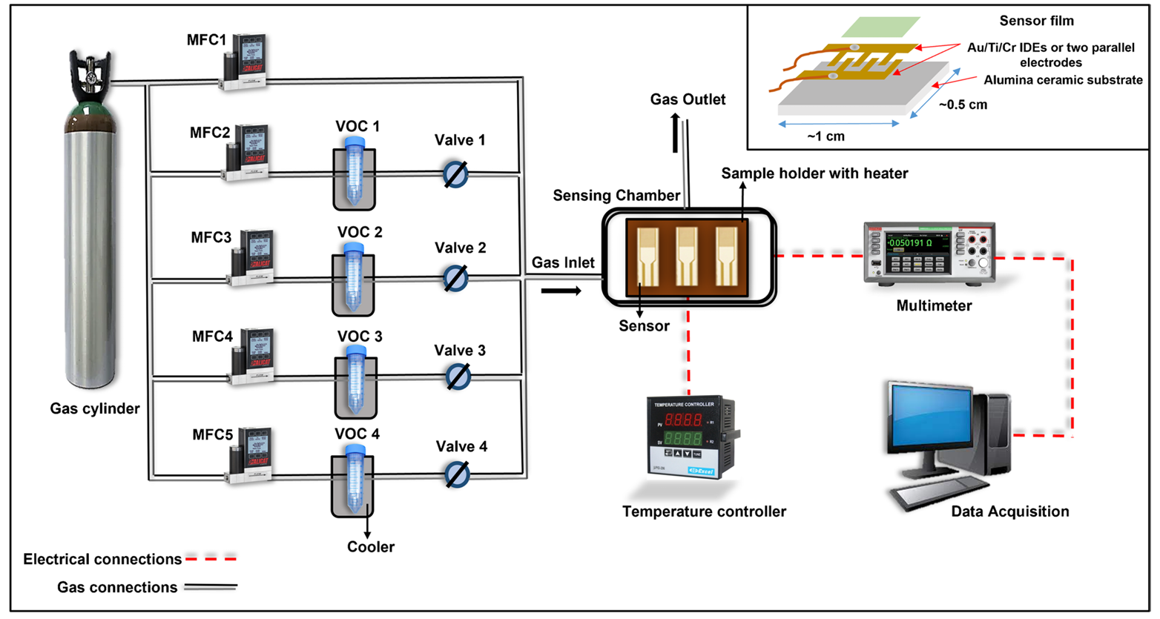
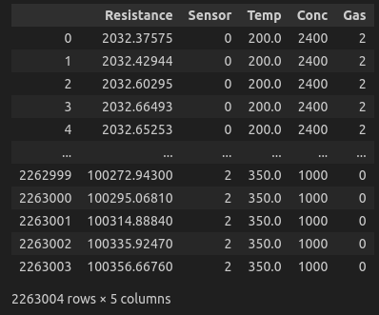
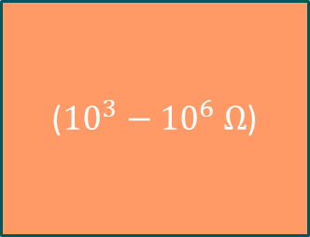
Volatile Organic Compound(VOC)
The schematic diagram of the gas sensing setup used for the experiment
S. Singh et al. “Metal oxide-based gas sensor array for VOCs determination in complex mixtures using machine learning”. In: Microchimica Acta 191.4 (2024). Published online: March 13, 2024, pp. 1–10. doi: 10.1007/s00604 024-06258-8.
(${10}^{3}−{10}^{6} Ω$)
Sensor
Gas
Resistance
NiO-Au(ohmic)
CuO-Au(Schottky)
ZnO-Au(Schottky)
Temperature
Concentration
Ethanol
Acetone
Toluene
Chloroform

Slide 4
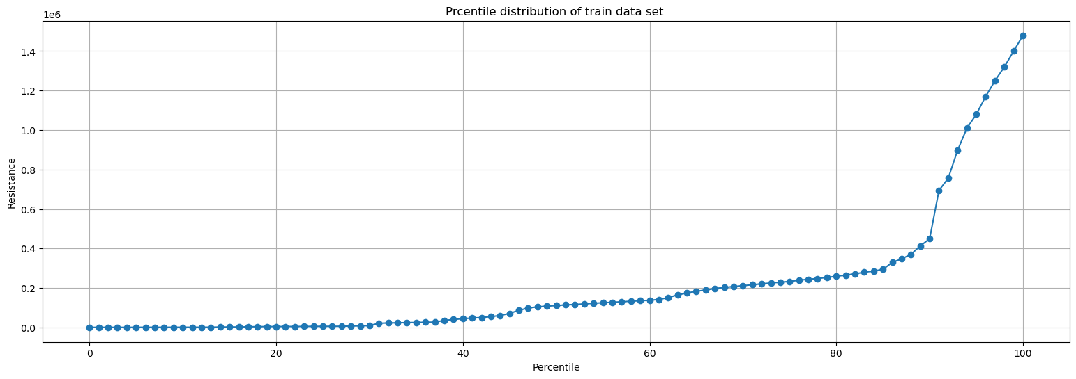
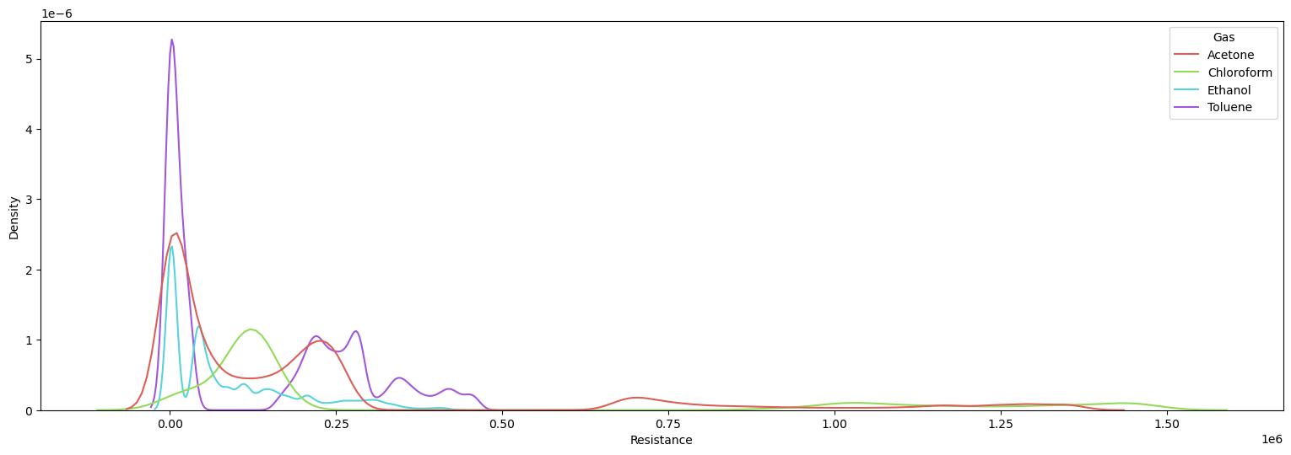
Preprocessing
22L points
K-Density Plot

Slide 5
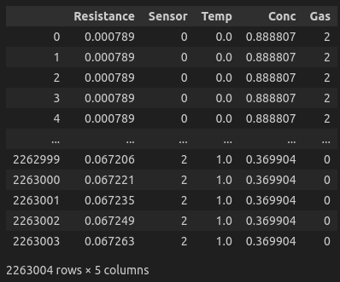
Preprocessing
Scaling (0-1)
Input features
Min-Max Scaler

Slide 6
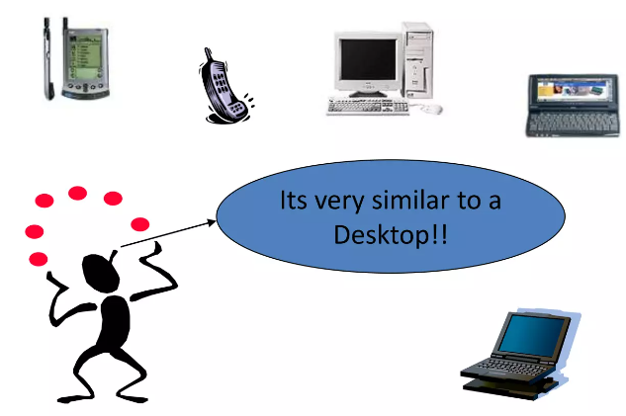
KNN(K Nearest Neighbor)
non-parametric, lazy learning algorithm
classification and regression tasks.
it doesn't build a model explicitly. Instead, it stores all available cases and classifies new cases based on their similarity to existing cases.
Given a dataset with labeled points,
classifies new data points by finding the 'K' nearest neighbors in the training data.
Classification the majority class among the K neighbors is assigned to the new data point.
Regression the output value for the new point is calculated as the average of the values of its K nearest neighbors.
Votes
Average

Slide 7
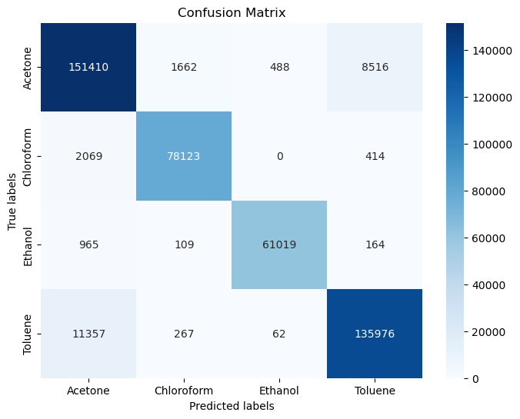
KNN
for KNN
K | 5
Train Data Points | 18 lac
Test Data points | 4 lac
Accuracy | 0.942523
Training Time | 18s
Test time | 21s

Slide 8

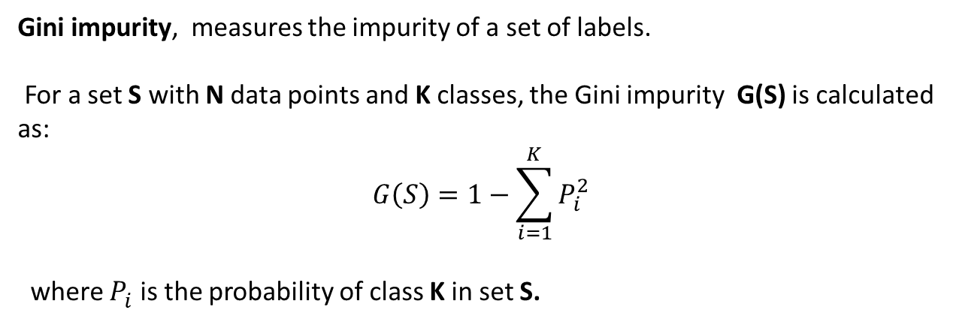
Decision Tree
Gini impurity, measures the impurity of a set of labels.
For a set S with N data points and K classes, the Gini impurity G(S) is calculated as:
$$G\left(S\right)=1−\sum_{i=1}^{K}{P_{i}^{2}}$$
where $P_{i}^{ }$ is the probability of class K in set S.
Decision tree
Find the split that minimizes the impurity of the resulting subsets.
Notes:
The tree is constructed recursively by repeatedly partitioning the data based on the selected splitting criteria until certain stopping criteria are met.
At each node, the algorithm searches for the best feature and threshold to split the data, aiming to minimize impurity.
This process continues until one of the stopping criteria is reached, such as reaching the maximum depth of the tree or no further reduction in impurity is possible.

Slide 9
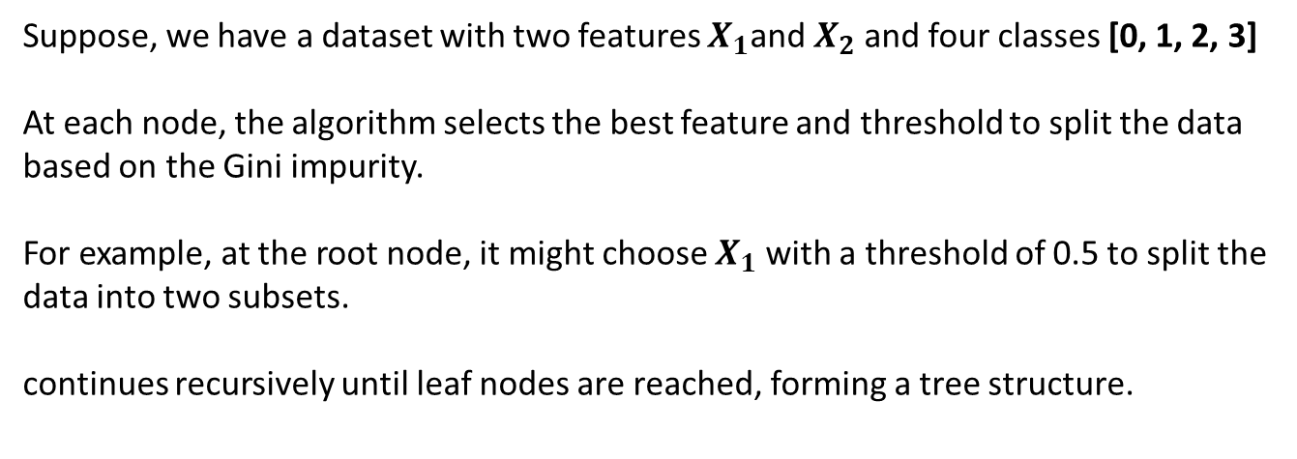
Decision Tree
Suppose, we have a dataset with two features $X_{1}$and $X_{2}$and four classes [0, 1, 2, 3]
At each node, the algorithm selects the best feature and threshold to split the data based on the Gini impurity.
For example, at the root node, it might choose $X_{1}$with a threshold of 0.5 to split the data into two subsets.
continues recursively until leaf nodes are reached, forming a tree structure.
Decision tree
Notes:
- To make a prediction for a new data point, its features are compared against the decision criteria at each node, and the corresponding class is assigned based on the leaf node reached.

Slide 10
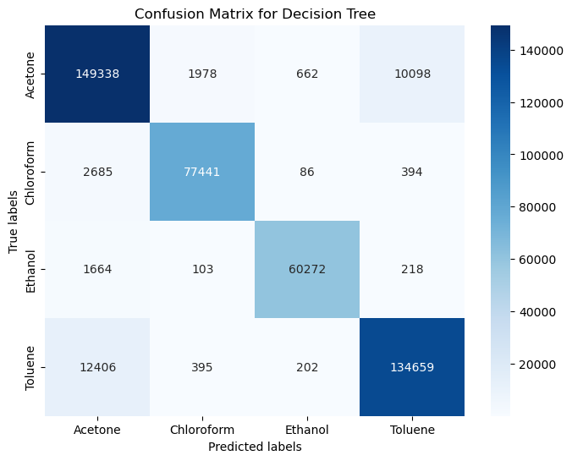
Decision Tree
Train Data Points | 18 lac
Test Data points | 4 lac
Accuracy | 0.9317
Training Time | 3s
Test time | ~0s
Notes:
- To make a prediction for a new data point, its features are compared against the decision criteria at each node, and the corresponding class is assigned based on the leaf node reached.

Slide 11
Random Forest
Random forest is an ensemble classifier which uses many decision trees.
It builds multiple decision trees and merges them together to get more accurate and stable prediction.
It can be used for both classification and regression problems

Slide 12
Random Forest
Algorithm
Create a bootstrapped dataset
Create a decision tree using the bootstrapped dataset, but only use a random subset of columns at each step.
Go back to step 1 and repeat.
Using a bootstrapped sample and considering only a subset of variables at each step results in a wide variety of trees.

Slide 13
Random Forest
Flow Chart of Algorithm
Begin
For each tree
Choose training data subset
Stop condition nodes at each node?
Yes
No
Build the next split
Calculate prediction error
End

Slide 14
Random Forest
Sample set
(M features, N points)
Bootstrap
sampling
Training set 1
Training set 2
Training set 3
….
Training set n
Generate forest
….
Decision tree 1
Decision tree 2
Decision tree 3
Decision tree n
Make Decision
voting

Slide 15
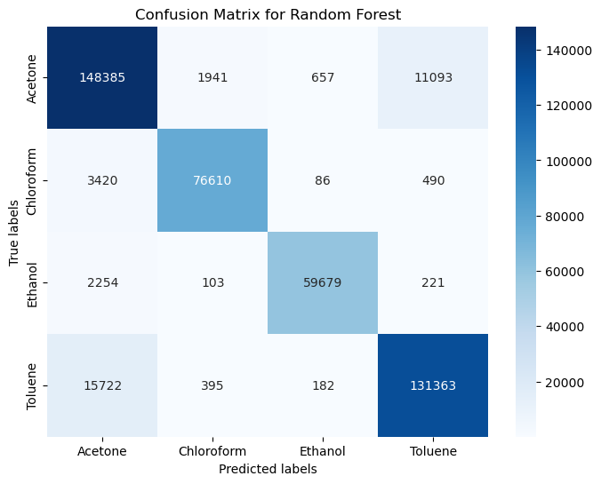
Random Forest
Train Data Points | 18 lac
Test Data points | 4 lac
Accuracy | 0.9192
Training Time | 2m10s
Test time | 5s

Slide 16
Neural Networks
Comparison
Biological Model
Neuron: an excitable cell
Synapse: connection between neurons
electrochemical pulse
collection of neurons along some pathway through the brain
Artificial Model
Neuron: node
Weight: multiplier on each edge
Activation Function
collection of neurons define some differentiable function

Slide 17

Neural Networks
Architecture
Input Layer
Hidden Layer
Hidden Layer
Output Layer
L1
L2
$$w$$

Slide 18
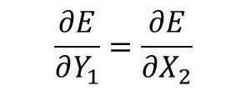
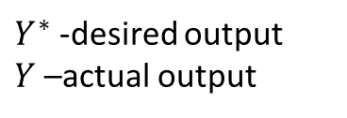
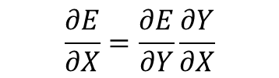


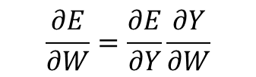
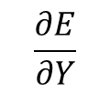


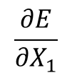



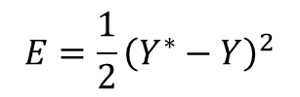

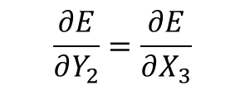

Neural Networks
Architecture
Y = network(X,W)
$$X_{1}$$
$$Y_{1}=X_{2}$$
$$Y_{2}=X_{3}$$
$$Y_{3}$$
$Y^{∗}$ -desired output
$Y$–actual output
L1
L2
L3
Y
Calculate the Error (MSE),
$$\frac{∂E}{∂X_{1}}$$
$$\frac{∂E}{∂Y_{3}}$$
$$\frac{∂E}{∂Y_{1}}=\frac{∂E}{∂X_{2}}$$
$$\frac{∂E}{∂Y_{2}}=\frac{∂E}{∂X_{3}}$$
$$E=\frac{1}{2}{\left(Y^{∗}−Y\right)}^{2}$$
$$X$$
$$Y$$
Adjust the parameters using gradient descent
W$→W−α\frac{∂E}{∂W}$
$$\frac{∂E}{∂W}=\frac{∂E}{∂Y}\frac{∂Y}{∂W}$$
$$\frac{∂E}{∂X}=\frac{∂E}{∂Y}\frac{∂Y}{∂X}$$
$$\frac{∂E}{∂X}$$
$$\frac{∂E}{∂Y}$$

Slide 19
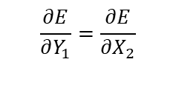




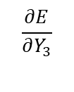





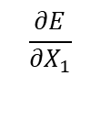








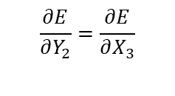


Neural Networks
Architecture
$$X_{1}$$
L1
$$Y_{1}=X_{2}$$
L2
$$Y_{2}=X_{3}$$
L3
$$Y_{3}$$
$$\frac{∂E}{∂X_{1}}$$
$$\frac{∂E}{∂Y_{3}}$$
$$\frac{∂E}{∂Y_{1}}=\frac{∂E}{∂X_{2}}$$
$$\frac{∂E}{∂Y_{2}}=\frac{∂E}{∂X_{3}}$$
Input Layer
Hidden Layer
L1
$$y_{1}$$
$$y_{1}=w_{11}x_{1}+w_{12}x_{2}+w_{13}x_{3}+b_{1}$$
$w_{ji}$ are the weights
$$x_{1}$$
$$y_{2}$$
$$y_{2}=w_{21}x_{1}+w_{22}x_{2}+w_{23}x_{3}+b_{2}$$
$$x_{2}$$
$$y_{3}$$
$$y_{3}=w_{31}x_{1}+w_{32}x_{2}+w_{33}x_{3}+b_{3}$$
$$x_{3}$$
$$w_{ji}$$
$$y_{4}$$
$$y_{4}=w_{41}x_{1}+w_{42}x_{2}+w_{43}x_{3}+b_{4}$$
$$i$$
$$j$$

Slide 20





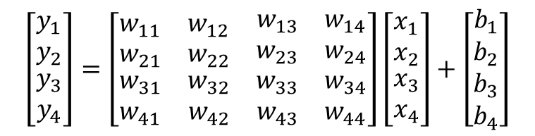










Neural Networks
Architecture
Input Layer
Hidden Layer
L1
$$y_{1}$$
$$y_{1}=w_{11}x_{1}+w_{12}x_{2}+w_{13}x_{3}+b_{1}$$
$w_{ji}$ are the weights
$$x_{1}$$
$$y_{2}$$
$$y_{2}=w_{21}x_{1}+w_{22}x_{2}+w_{23}x_{3}+b_{2}$$
$$x_{2}$$
$$y_{3}$$
$$y_{3}=w_{31}x_{1}+w_{32}x_{2}+w_{33}x_{3}+b_{3}$$
$$x_{3}$$
$$w_{ji}$$
$$y_{4}$$
$$y_{4}=w_{41}x_{1}+w_{42}x_{2}+w_{43}x_{3}+b_{4}$$
$$i$$
$$j$$
$$\left[\begin{matrix}y_{1} \\ y_{2} \\ \begin{matrix}y_{3} \\ y_{4}\end{matrix}\end{matrix}\right]=\left[\begin{matrix}w_{11} & w_{12} & \begin{matrix}w_{13} & w_{14}\end{matrix} \\ w_{21} & w_{22} & \begin{matrix}w_{23} & w_{24}\end{matrix} \\ \begin{matrix}w_{31} \\ w_{41}\end{matrix} & \begin{matrix}w_{32} \\ w_{42}\end{matrix} & \begin{matrix}\begin{matrix}w_{33} & w_{34}\end{matrix} \\ \begin{matrix}w_{43} & w_{44}\end{matrix}\end{matrix}\end{matrix}\right]\left[\begin{matrix}x_{1} \\ x_{2} \\ \begin{matrix}x_{3} \\ x_{4}\end{matrix}\end{matrix}\right]+\left[\begin{matrix}b_{1} \\ b_{2} \\ \begin{matrix}b_{3} \\ b_{4}\end{matrix}\end{matrix}\right]$$

Slide 21

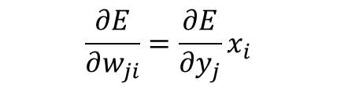
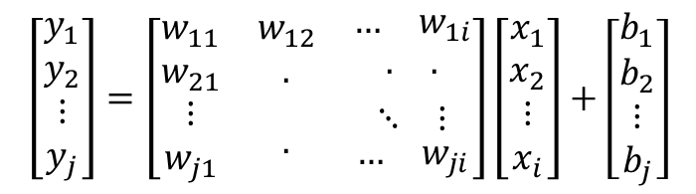

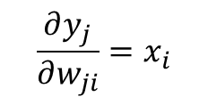
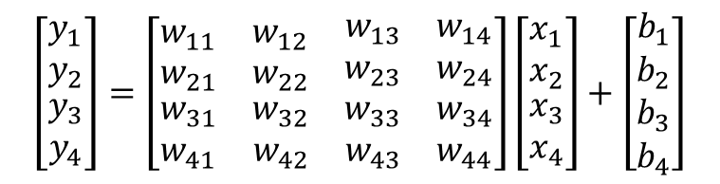
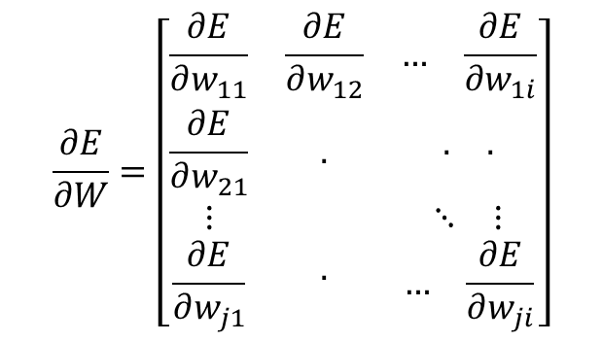

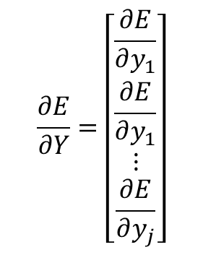



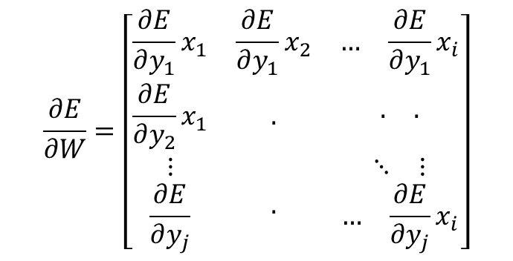
Neural Networks
$$y_{1}=w_{11}x_{1}+w_{12}x_{2}+w_{13}x_{3}+b_{1}$$
Architecture
$$y_{2}=w_{21}x_{1}+w_{22}x_{2}+w_{23}x_{3}+b_{2}$$
$$\left[\begin{matrix}y_{1} \\ y_{2} \\ \begin{matrix}y_{3} \\ y_{4}\end{matrix}\end{matrix}\right]=\left[\begin{matrix}w_{11} & w_{12} & \begin{matrix}w_{13} & w_{14}\end{matrix} \\ w_{21} & w_{22} & \begin{matrix}w_{23} & w_{24}\end{matrix} \\ \begin{matrix}w_{31} \\ w_{41}\end{matrix} & \begin{matrix}w_{32} \\ w_{42}\end{matrix} & \begin{matrix}\begin{matrix}w_{33} & w_{34}\end{matrix} \\ \begin{matrix}w_{43} & w_{44}\end{matrix}\end{matrix}\end{matrix}\right]\left[\begin{matrix}x_{1} \\ x_{2} \\ \begin{matrix}x_{3} \\ x_{4}\end{matrix}\end{matrix}\right]+\left[\begin{matrix}b_{1} \\ b_{2} \\ \begin{matrix}b_{3} \\ b_{4}\end{matrix}\end{matrix}\right]$$
$$y_{3}=w_{31}x_{1}+w_{32}x_{2}+w_{33}x_{3}+b_{3}$$
$$y_{4}=w_{41}x_{1}+w_{42}x_{2}+w_{43}x_{3}+b_{4}$$
$$\frac{∂y_{j}}{∂w_{ji}}=x_{i}$$
$$\left[\begin{matrix}y_{1} \\ y_{2} \\ \begin{matrix}⋮ \\ y_{j}\end{matrix}\end{matrix}\right]=\left[\begin{matrix}w_{11} & w_{12} & \begin{matrix}… & w_{1i}\end{matrix} \\ w_{21} & . & \begin{matrix}. & .\end{matrix} \\ \begin{matrix}⋮ \\ w_{j1}\end{matrix} & . & \begin{matrix}\begin{matrix}⋱ & ⋮\end{matrix} \\ \begin{matrix}… & w_{ji}\end{matrix}\end{matrix}\end{matrix}\right]\left[\begin{matrix}x_{1} \\ x_{2} \\ \begin{matrix}⋮ \\ x_{i}\end{matrix}\end{matrix}\right]+\left[\begin{matrix}b_{1} \\ b_{2} \\ \begin{matrix}⋮ \\ b_{j}\end{matrix}\end{matrix}\right]$$
$$y_{j }={ w}_{j1}x_{1}+ w_{j2}x_{2} + … + w_{ji}x_{i} + b_{j}$$
$$\frac{∂E}{∂w_{ji}}=\frac{∂E}{∂y_{j}}x_{i}$$
$$Y=W∙X+B$$
$$\frac{∂E}{∂Y}=\left[\begin{matrix}\frac{∂E}{∂y_{1}} \\ \frac{∂E}{∂y_{1}} \\ \begin{matrix}⋮ \\ \frac{∂E}{∂y_{j}}\end{matrix}\end{matrix}\right]$$
$$\frac{∂E}{∂W}=\left[\begin{matrix}\frac{∂E}{∂w_{11}} & \frac{∂E}{∂w_{12}} & \begin{matrix}… & \frac{∂E}{∂w_{1i}}\end{matrix} \\ \frac{∂E}{∂w_{21}} & . & \begin{matrix}. & .\end{matrix} \\ \begin{matrix}⋮ \\ \frac{∂E}{∂w_{j1}}\end{matrix} & . & \begin{matrix}\begin{matrix}⋱ & ⋮\end{matrix} \\ \begin{matrix}… & \frac{∂E}{∂w_{ji}}\end{matrix}\end{matrix}\end{matrix}\right]$$
$$\frac{∂E}{∂W}=\left[\begin{matrix}\frac{∂E}{∂y_{1}}x_{1} & \frac{∂E}{∂y_{1}}x_{2} & \begin{matrix}… & \frac{∂E}{∂y_{1}}x_{i}\end{matrix} \\ \frac{∂E}{∂y_{2}}x_{1} & . & \begin{matrix}. & .\end{matrix} \\ \begin{matrix}⋮ \\ \frac{∂E}{∂y_{j}}\end{matrix} & . & \begin{matrix}\begin{matrix}⋱ & ⋮\end{matrix} \\ \begin{matrix}… & \frac{∂E}{∂y_{j}}x_{i}\end{matrix}\end{matrix}\end{matrix}\right]$$
and

Slide 22
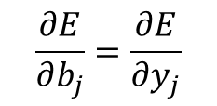
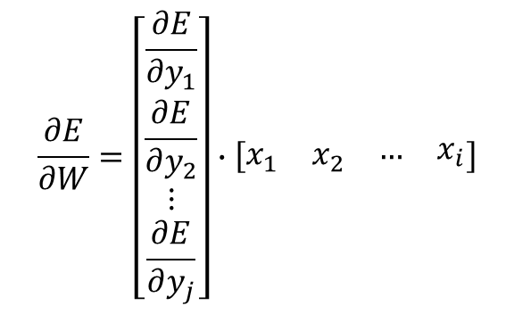
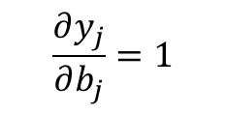
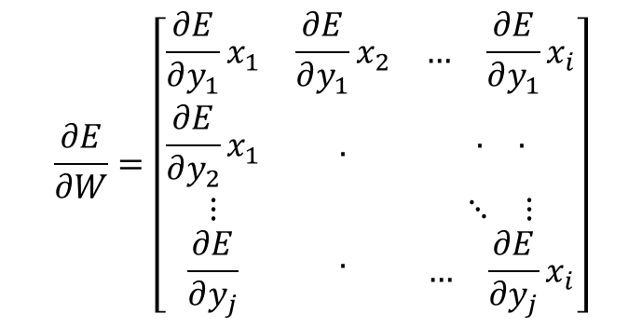

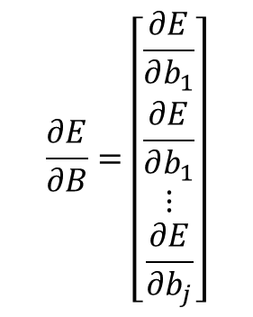
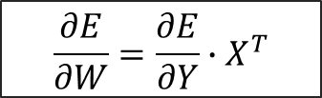
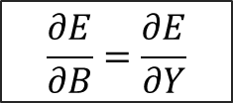
Neural Networks
Architecture
$$y_{j }={ w}_{j1}x_{1}+ w_{j2}x_{2} + … + w_{ji}x_{i} + b_{j}$$
$$\frac{∂E}{∂W}=\left[\begin{matrix}\frac{∂E}{∂y_{1}}x_{1} & \frac{∂E}{∂y_{1}}x_{2} & \begin{matrix}… & \frac{∂E}{∂y_{1}}x_{i}\end{matrix} \\ \frac{∂E}{∂y_{2}}x_{1} & . & \begin{matrix}. & .\end{matrix} \\ \begin{matrix}⋮ \\ \frac{∂E}{∂y_{j}}\end{matrix} & . & \begin{matrix}\begin{matrix}⋱ & ⋮\end{matrix} \\ \begin{matrix}… & \frac{∂E}{∂y_{j}}x_{i}\end{matrix}\end{matrix}\end{matrix}\right]$$
$$\frac{∂E}{∂B}=\left[\begin{matrix}\frac{∂E}{∂b_{1}} \\ \frac{∂E}{∂b_{1}} \\ \begin{matrix}⋮ \\ \frac{∂E}{∂b_{j}}\end{matrix}\end{matrix}\right]$$
$$\frac{∂y_{j}}{∂b_{j}}=1$$
$$\frac{∂E}{∂b_{j}}=\frac{∂E}{∂y_{j}}$$
$$\frac{∂E}{∂B}=\frac{∂E}{∂Y}$$
$$\frac{∂E}{∂W}=\left[\begin{matrix}\frac{∂E}{∂y_{1}} \\ \frac{∂E}{∂y_{2}} \\ \begin{matrix}⋮ \\ \frac{∂E}{∂y_{j}}\end{matrix}\end{matrix}\right]∙\left[\begin{matrix}x_{1} & x_{2} & \begin{matrix}… & x_{i}\end{matrix}\end{matrix}\right]$$
$$\frac{∂E}{∂W}=\frac{∂E}{∂Y}∙X^{T}$$

Slide 23
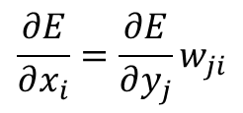
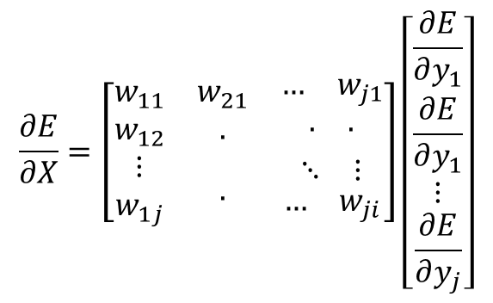
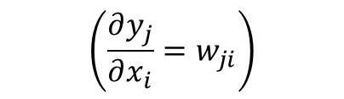
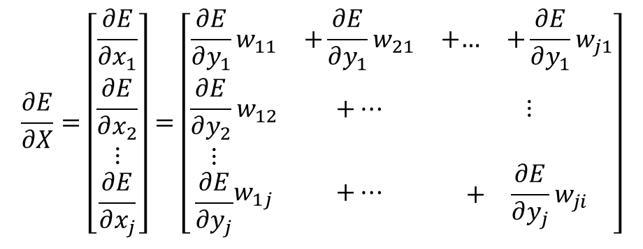

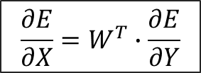
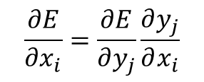
Neural Networks
Architecture
$$y_{j }={ w}_{j1}x_{1}+ w_{j2}x_{2} + … + w_{ji}x_{i} + b_{j}$$
$$\frac{∂E}{∂X}=\left[\begin{matrix}w_{11} & w_{21} & \begin{matrix}… & w_{j1}\end{matrix} \\ w_{12} & . & \begin{matrix}. & .\end{matrix} \\ \begin{matrix}⋮ \\ w_{1j}\end{matrix} & . & \begin{matrix}\begin{matrix}⋱ & ⋮\end{matrix} \\ \begin{matrix}… & w_{ji}\end{matrix}\end{matrix}\end{matrix}\right]\left[\begin{matrix}\frac{∂E}{∂y_{1}} \\ \frac{∂E}{∂y_{1}} \\ \begin{matrix}⋮ \\ \frac{∂E}{∂y_{j}}\end{matrix}\end{matrix}\right]$$
$$\frac{∂E}{∂x_{i}}=\frac{∂E}{∂y_{j}}\frac{∂y_{j}}{∂x_{i}}$$
$$\left(\frac{∂y_{j}}{∂x_{i}}=w_{ji}\right)$$
$$\frac{∂E}{∂x_{i}}=\frac{∂E}{∂y_{j}}w_{ji}$$
$$\frac{∂E}{∂X}=W^{T}∙\frac{∂E}{∂Y}$$
$$\frac{∂E}{∂X}=\left[\begin{matrix}\frac{∂E}{∂x_{1}} \\ \frac{∂E}{∂x_{2}} \\ \begin{matrix}⋮ \\ \frac{∂E}{∂x_{j}}\end{matrix}\end{matrix}\right]=\left[\begin{matrix}\frac{∂E}{∂y_{1}}w_{11} & +\frac{∂E}{∂y_{1}}w_{21} & +\begin{matrix}… & +\frac{∂E}{∂y_{1}}w_{j1}\end{matrix} \\ \frac{∂E}{∂y_{2}}w_{12} & +… & ⋮ \\ \begin{matrix}⋮ \\ \frac{∂E}{∂y_{j}}\end{matrix}w_{1j} & +… & \begin{matrix} \\ \begin{matrix}+ & \frac{∂E}{∂y_{j}}w_{ji}\end{matrix}\end{matrix}\end{matrix}\right]$$

Slide 24





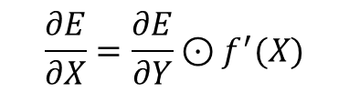

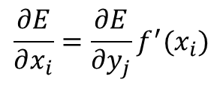



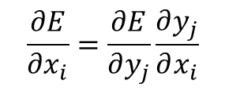




Neural Networks
Architecture
Activation Function
L1
$$x_{1}$$
$$y_{1}=f(x_{1})$$
$$y_{1}$$
$$x_{1}$$
$$\frac{∂E}{∂X}=\left[\begin{matrix}\frac{∂E}{∂x_{1}} \\ \frac{∂E}{∂x_{2}} \\ \begin{matrix}⋮ \\ \frac{∂E}{∂x_{j}}\end{matrix}\end{matrix}\right]$$
$$y_{2}$$
$$x_{2}$$
$$\frac{∂E}{∂x_{i}}=\frac{∂E}{∂y_{j}}\frac{∂y_{j}}{∂x_{i}}$$
and
$$y_{3}$$
$$x_{3}$$
$$w_{ji}$$
$$y_{4}$$
$$\frac{∂E}{∂x_{i}}=\frac{∂E}{∂y_{j}}f^{′}(x_{i})$$
$$i$$
$$j$$
$$\frac{∂E}{∂X}=\frac{∂E}{∂Y}⊙f^{′}(X)$$

Slide 25











Neural Networks
Architecture
$$Y^{∗}=\left[\begin{matrix}y_{1}^{∗} \\ y_{2}^{∗} \\ \begin{matrix}⋮ \\ y_{j}^{∗}\end{matrix}\end{matrix}\right]$$
$$Y=\left[\begin{matrix}y_{1} \\ y_{2} \\ \begin{matrix}⋮ \\ y_{j}\end{matrix}\end{matrix}\right]$$
Calculate the Error (MSE),
$Y^{∗}$ -desired output
$Y$–actual output
$$\frac{∂E}{∂Y}=\left[\begin{matrix}\frac{∂E}{∂y_{1}} \\ \frac{∂E}{∂y_{1}} \\ \begin{matrix}⋮ \\ \frac{∂E}{∂y_{j}}\end{matrix}\end{matrix}\right]$$
$$E=\frac{1}{n}\sum_{j=1}^{n}{{\left(y_{j}^{∗}−y_{j}\right)}^{2}}$$
$$\frac{∂E}{∂Y}=\frac{2}{n}(Y^{∗}−f(X))$$
$$\frac{∂E}{∂X}=\frac{∂E}{∂Y}⊙f^{′}(X)$$
$$\frac{∂E}{∂y_{j}}=\frac{2}{n}(y_{j}^{∗}−y_{j})$$
$$\frac{∂E}{∂Y}=\frac{2}{n}(Y^{∗}−Y)$$
$$\frac{∂E}{∂X}=\left(\frac{2}{n}(Y^{∗}−f(X))\right)⊙f^{′}(X)$$
$$\frac{∂E}{∂W}=\left(\frac{2}{n}(Y^{∗}−f(X))\right)∙X^{T}$$

Slide 26




Neural Networks
Activation Function
Sigmoid
ReLU
$$S\left(x\right)=\frac{1}{1+e^{−x}}$$
$$f\left(x\right)=max⁡(0,x)$$

Slide 27
Neural Networks
Model Training
The batch size is a number of samples processed before the model is updated.
The number of epochs is the number of complete passes through the training dataset.
Notes:
when all the data samples have been exposed to the neural network for learning patterns, one epoch is said to be completed.

Slide 28
Neural Networks
Model Training
Train model on Training set
Evaluate model on Validation set
Tweak model according to results on validation Set
Pick model that does best on Validation Set
Confirm Results on Test Set
Notes:
when all the data samples have been exposed to the neural network for learning patterns, one epoch is said to be completed.

Slide 29


Neural Networks
loss | 0.1341156
Accuracy | 0.93225824
Time | 23m4s
epoch | 50
Batch size | 32
Validation split | 0.1
Model Training

Slide 30

Neural Networks
Result
for NN
Train Data Points | 18 lac
Test Data points | 4 lac
Accuracy | 0.91743
Training Time | 23m
Test time | 9s

Slide 31
Results
for KNN
for NN

Slide 32


Slide 33


Slide 34

Conclusion
PCA
KNN, Decision tree, Random forest and NN.
accuracy of above 90%.
New Six Sensor Setup.
~ Skew Results
Notes:
The data collected with 3 sensor arrays was analysed using machine learning techniques.
The main method for analysis relied on the dimensional reduction method to visualise data and ML methods for the classification of the data.
However, the decision tree model gave the fastest result compared to other models.

